Slide 1

Asynchronous architectures
Examples of asynchronous architectures
Common design options
Push notifications and iOS / Android
Queueing and Twitter (aka X)

Slide 2
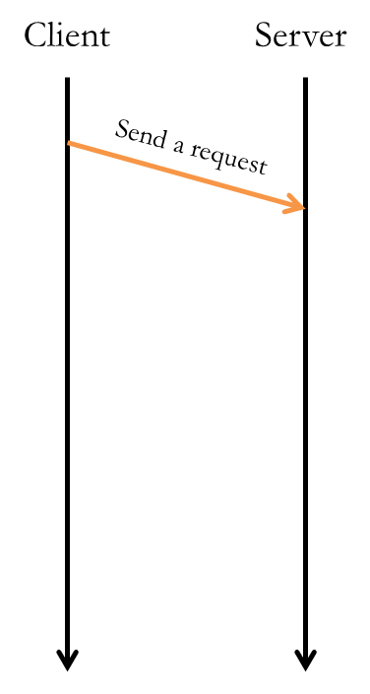
Some requests don't need a response
Sending email / txt msg
Posting to social media
Likes
The server performs some function asynchronously…

Slide 3
Asynchronous architectures
When the server wants to initiate communication
Notifications on your phone…
Uber: your car has arrived
GrubHub: your food has arrived
Amazon: your package has shipped
Common use cases:
Texting
Messaging apps
Notification systems
Workflow systems (documents, food delivery)
Streaming services (music, audiobooks, videos)
Client
Server
Message #1…
Message #2…

Slide 4
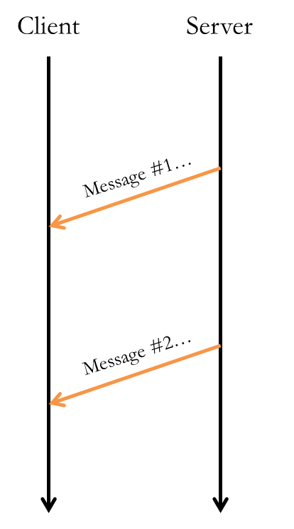
Servers notifying people
Many services notify users by sending email or txt
Send email by connecting to an SMTP server
AWS SES (simple email service)
Send SMS messages using a txting service
Twilio or AWS SNS (simple notification service)
Does not work well for notifying apps…
4

Slide 5
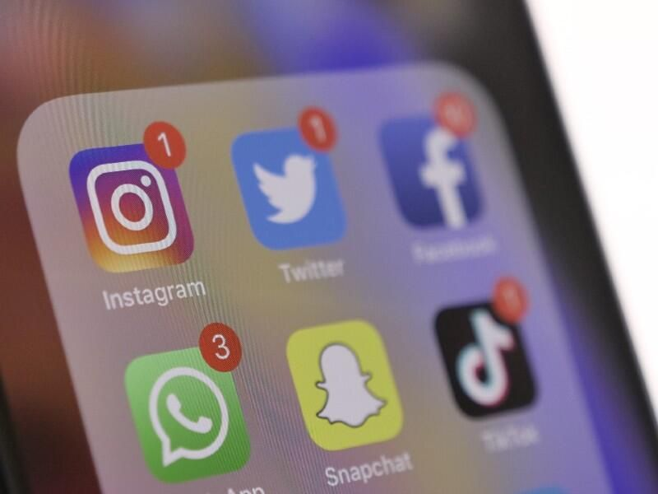
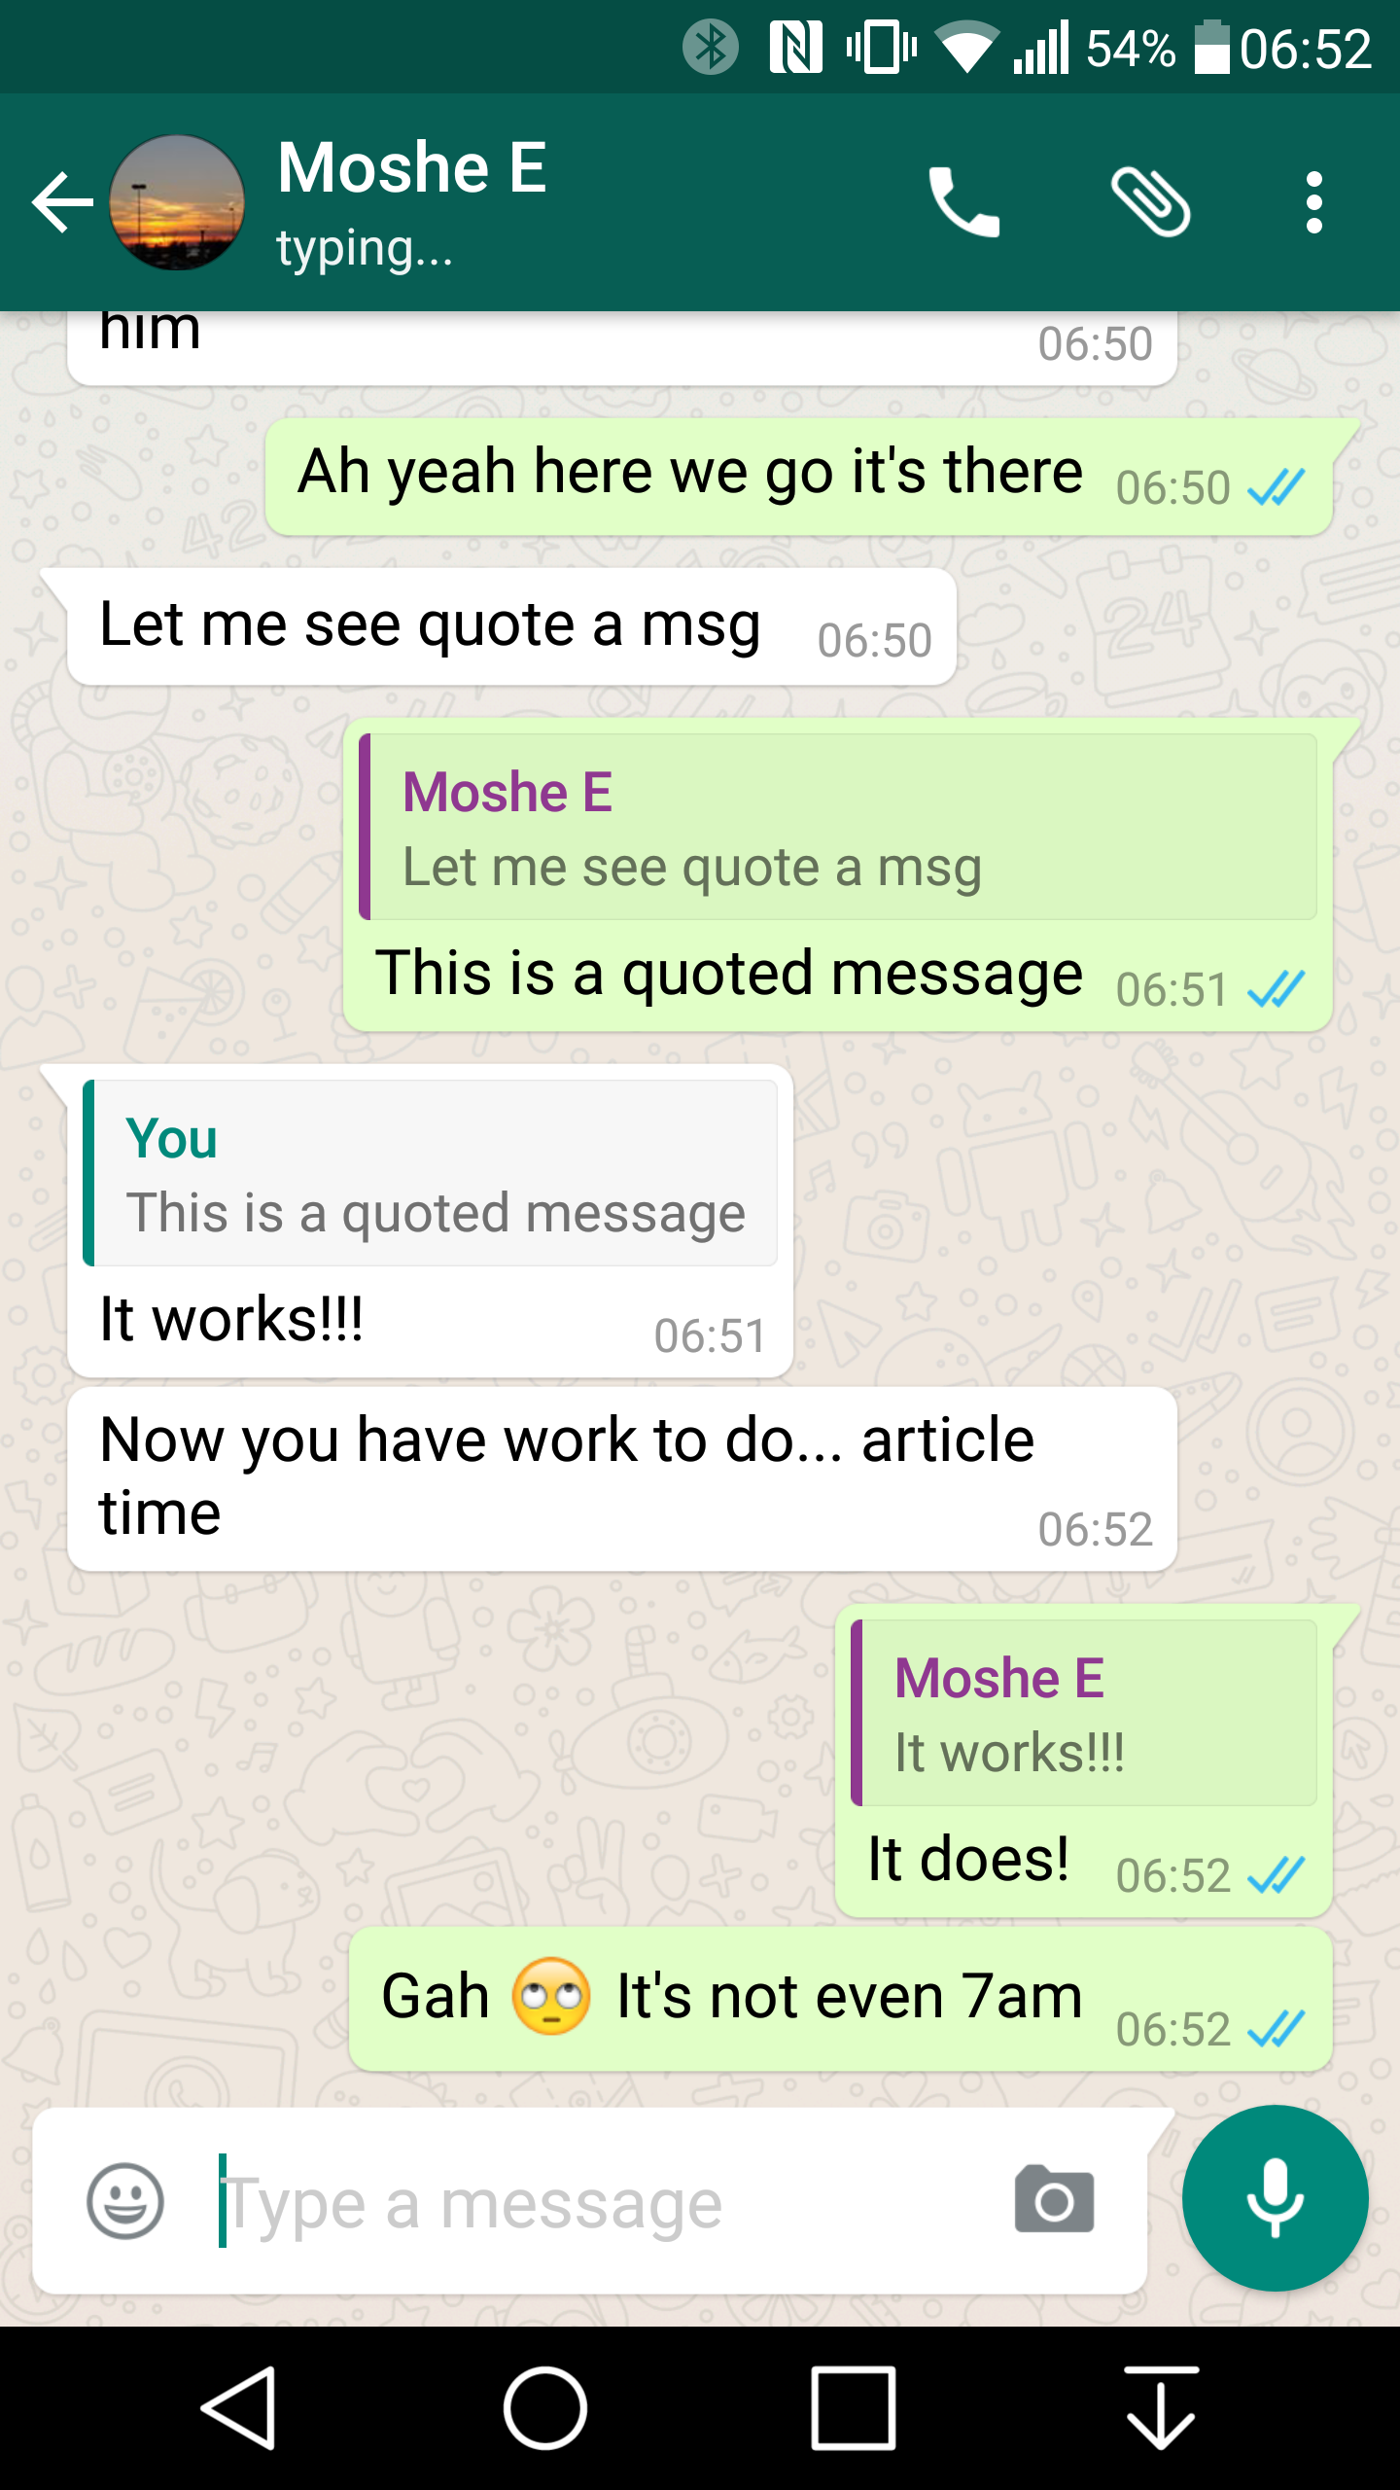



Servers notifying apps
Most notifications are targeting the apps on your phone
Messages, WhatsApp, Instagram, Snapchat, TikTok, Twitter/X, …
WhatsApp back-end server

Slide 6
Decoupling enables scaling
Asynchronous systems decouple "producers" from "consumers"
Producer
Producer
Producer
Producer
Producer
Producer
Consumer
Producer
???
6

Slide 7
Push notifications
Push notifications are a great way for servers / systems to reach us…

Slide 8
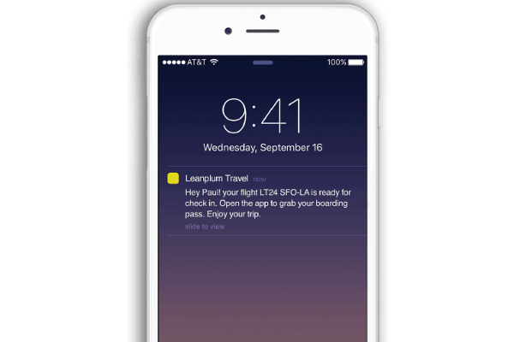
Push Notification Service
Key points:
Client OS registers one connection for all apps
App servers send notifications to device through Apple (iOS) or Google (Android) notification service
Completely asynchronous
Apple Push Notification service (APNs)
Public Internet
Notifications Queued for delivery
WhatsApp
back-end server
User DB
Register…
Notifications
8

Slide 9

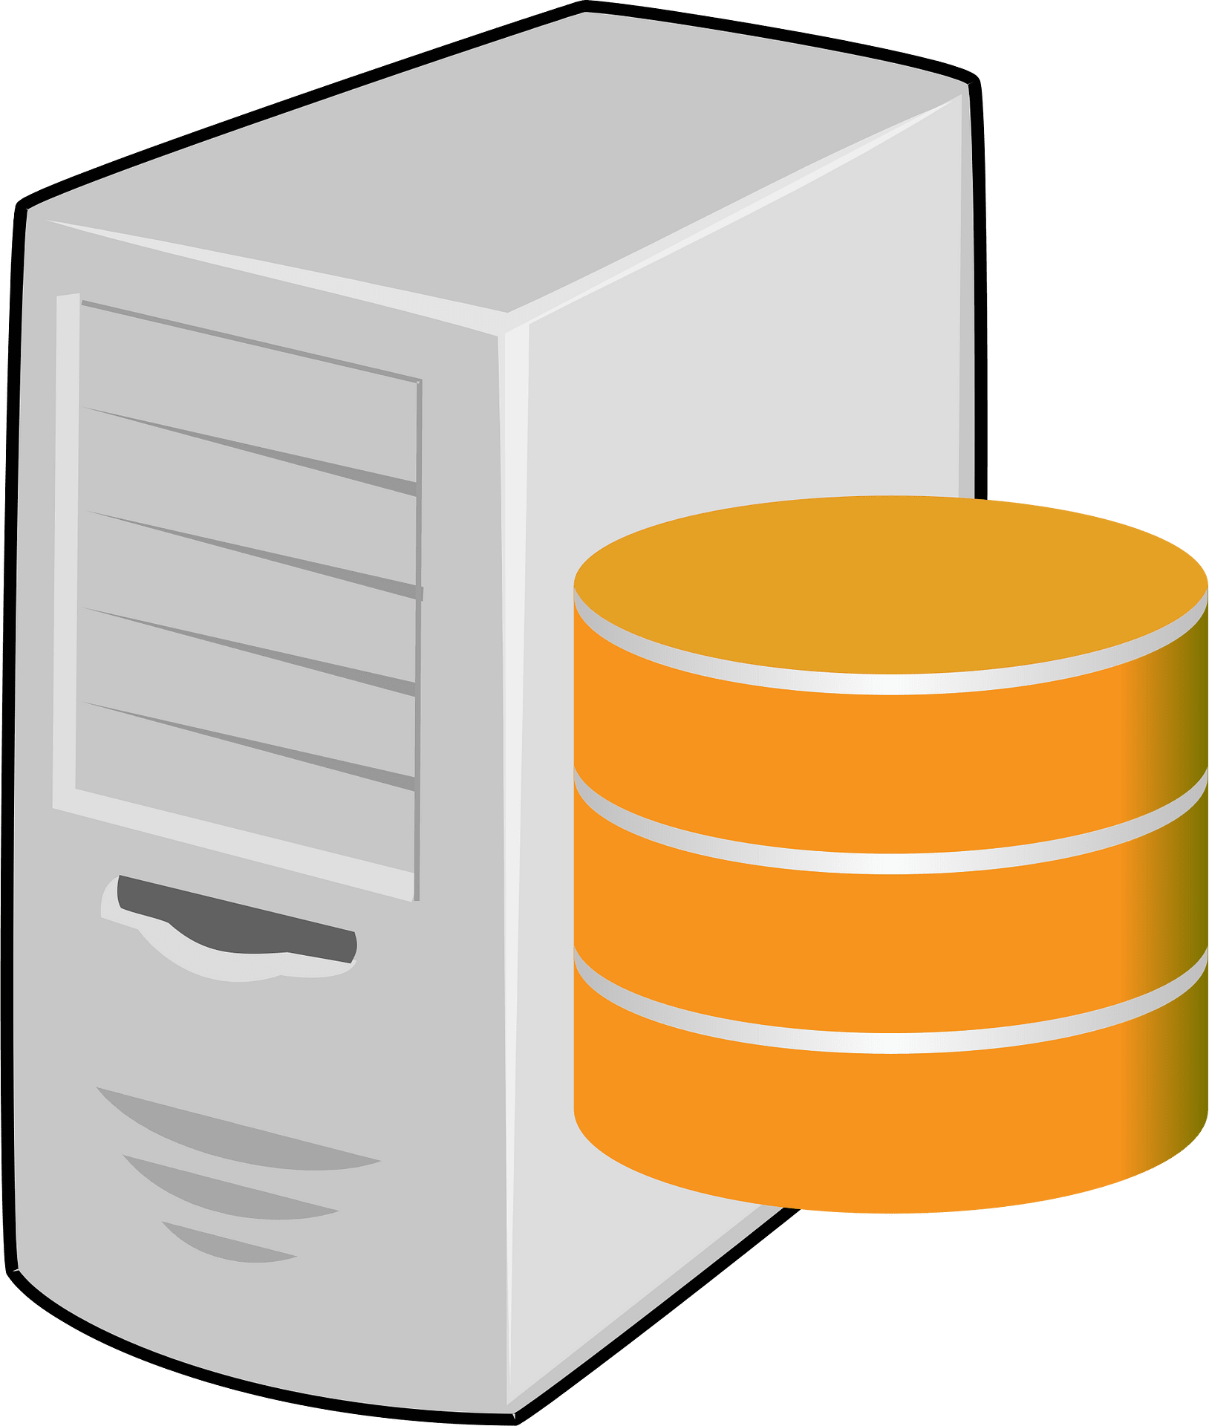
Think about the scale…
Thousands of producers
Producing billions of notifications
Delivered to billions of consumers
Apple Push Notification service (APNs)
Notifications Queued for delivery

Slide 10
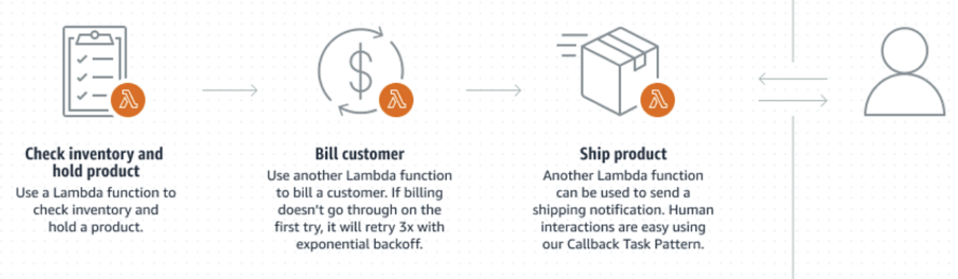
Design options
Classis async architectures use queueing
AWS SQS == simple queueing service
Other options:
Use a database to store / retrieve notifications
SNS == simple notification service (real-time, e.g. chat msgs)
S3 / DynamoDB / Kinesis == predefined event-based triggers
EventBridge == custom event service
Step Functions == build workflows with Lambda functions

Slide 11
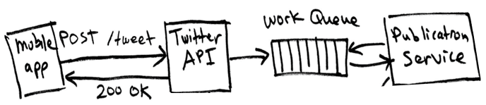
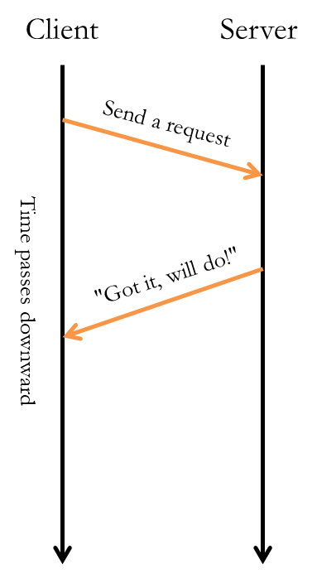
Message queues
Message queues store requests that need to be processed
Client calls server --- server enqueues a work message
Another server dequeues message & processes
11

Slide 12
Queueing scales
Producer
Producer
Producer
Producer
Producer
Producer
Consumer
Producer
Message Queue
Message queues are a simple kind of database – store work requests
Queues smooth demand peaks by decoupling producers & consumers
Many producers and many consumers can connect to a queue
AWS SQS == Simple Queueing Service
12

Slide 13
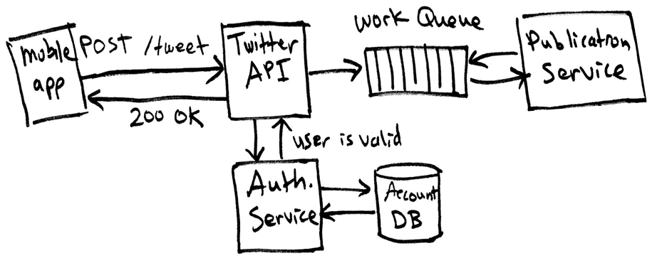
1. Client posts tweet
Example: Twitter (aka X)
API service receives request
Puts a tweet-creation job on a queue
Sends “acknowledgement” response back to user
13

Slide 14
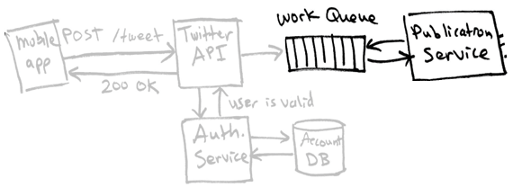
2. Publication service handles the post
Publication service fetches message
Posts tweet
Gets a list of followers to receive the tweet
Adds the new tweet to all the followers’ feeds
14

Slide 15
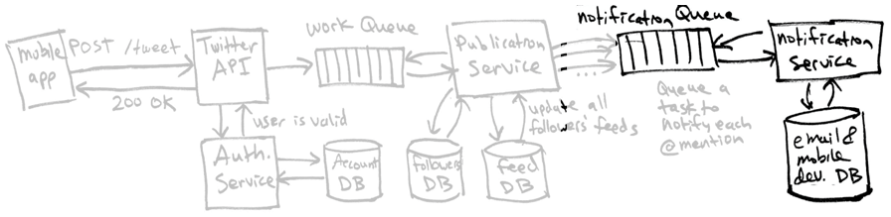
3. Notification service alerts users
There may be millions of notifications in the queue based on the original tweet
Notification service dequeues each one and notifies user
What happens if there is a failure?
Retry a few times, and then give up --- the original tweeter does not care
15

Slide 16
That's it, thank you!

Slide 17
Back pressure
What happens if a queue "fills up"?
Queue should give an error to the producer trying to post --- retry?
This can have a ripple effect of delays across the system, and needs to be avoided…
Automatic & manual monitoring must exist to adjust queue sizes and throttle work requests

Slide 18
Smartphone Notifications
Apple & Google run a push notification service (PNS) for apps
Apple Push Notifications (APN) & Google Cloud Messaging (GCM)
Whenever phone gets a new IP address, the OS opens a long-lived connection to the PNS, registers ⟨user id, IP address⟩
At launch an app registers ⟨app, IP address⟩ with PNS, receives "device token" to uniquely identify device, forwards token to back-end server (cloud)
When app server wants to notify the app, it sends notification to the PNS: ⟨device token, message⟩
The PNS relays the message to the user’s current IP address
OS shows notification (not the app)
18

